Slide 1

Chapter 4
Dynamic Testing: Black Box Testing Techniques
Objectives
Black box testing ignores the structural details of the software.
Test case designing using black box techniques.
Boundary value analysis method
Equivalence class testing method
State table based testing method
Decision table based testing method
Cause-effect graphing method
© Oxford University Press 2011. All rights reserved.

Slide 2
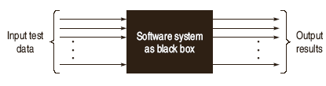
Evolution of Software Testing
Black Box Testing
© Oxford University Press 2011. All rights reserved.

Slide 3
Evolution of Software Testing
Black Box Testing
To test the modules independently.
To test the functional validity of the software
Interface errors are detected.
To test the system behavior and check its performance.
To test the maximum load or stress on the system.
Customer accepts the system within defined acceptable limits.
© Oxford University Press 2011. All rights reserved.

Slide 4
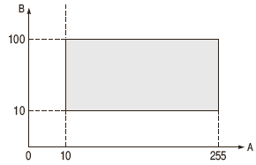
Boundary Value Analysis (BVA)
© Oxford University Press 2011. All rights reserved.

Slide 5
Boundary Value Checking
Test cases are designed by holding one variable at its extreme value and other variables at their nominal values in the input domain. The variable at its extreme value can be selected at:
  Minimum value (Min)
  Value just above the minimum value (Min+ )
  Maximum value (Max)
  Value just below the maximum value (Max-)
© Oxford University Press 2011. All rights reserved.

Slide 6
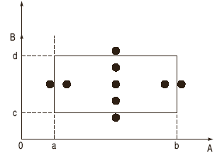
Boundary Value Checking
Anom, Bmin
Anom, Bmin+
Anom, Bmax
Anom, Bmax-
Amin, Bnom
Amin+, Bnom
Amax, Bnom
Amax-, Bnom
Anom, Bnom
4n+1 test cases can be designed with boundary value checking method.
© Oxford University Press 2011. All rights reserved.

Slide 7
Robustness Testing Method
    A value just greater than the Maximum value (Max+)
    A value just less than Minimum value (Min-)
When test cases are designed considering above points in addition to BVC, it is called Robustness testing.
Amax+, Bnom
Amin-, Bnom
Anom, Bmax+
Anom, Bmin-
It can be generalized that for n input variables in a module, 6n+1 test cases are designed with Robustness testing.
© Oxford University Press 2011. All rights reserved.

Slide 8
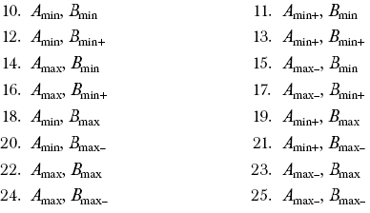
Software Testing Myths
Worst Case Testing Method
When more than one variable are in extreme values, i.e. when more than one variable are on the boundary. It is called Worst case testing method.
It can be generalized that for n input variables in a module, 5^{n} test cases are designed with worst case testing.
© Oxford University Press 2011. All rights reserved.

Slide 9
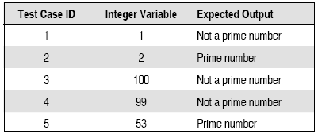
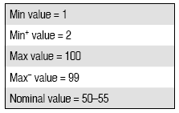
Example
A program reads an integer number within the range [1,100] and determines whether the number is a prime number or not. Design all test cases for this program using BVC, Robust testing and worst-case testing methods.
1) Test cases using BVC
© Oxford University Press 2011. All rights reserved.

Slide 10
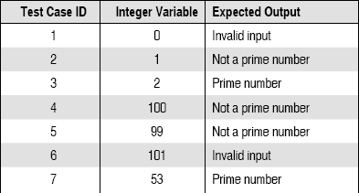
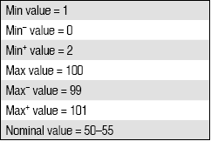
Example
Test Cases Using Robust Testing
© Oxford University Press 2011. All rights reserved.

Slide 11
BVC
Problem Domain: "The triangle program accepts three integers, a, b and c as input. These are taken to be the sides of a triangle. The integers a, b and c must satisfy the following conditions
C1: 1 ≤ a ≤ 200
C2: 1 ≤ b ≤ 200
C3: 1 ≤ c ≤ 200
C4: a < b+c
C5: b < a+c
C6: c < a+b
The output of the program may be either of: Equilateral Triangle, Isosceles Triangle, Scalene or "Not a Traingle".
© Oxford University Press 2011. All rights reserved.

Slide 12
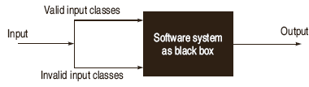
Equivalence Class Testing
© Oxford University Press 2011. All rights reserved.

Slide 13
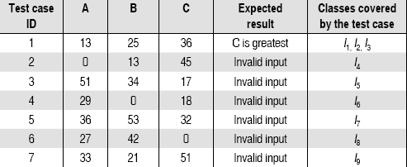
Example
A program reads three numbers A, B and C with range [1,50] and prints largest number. Design all test cases for this program using equivalence class testing technique.
I1 = {<A,B,C> : 1 ≤ A ≤ 50}
I2 = {<A,B,C> : 1 ≤ B ≤ 50}
I3 = {<A,B,C> : 1 ≤ C ≤ 50}
I4 = {<A,B,C> : A < 1}
I5 = {<A,B,C> : A > 50}
I6 = {<A,B,C> : B < 1}
I7 = {<A,B,C> : B > 50}
I8 = {<A,B,C> : C < 1}
I9 = {<A,B,C> : C > 50}
© Oxford University Press 2011. All rights reserved.

Slide 14
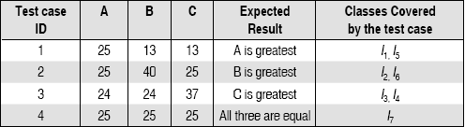
Example
I1 = {<A,B,C> : A > B, A > C}
I2 = {<A,B,C> : B > A, B > C}
I3 = {<A,B,C> : C > A, C > B}
I4 = {<A,B,C> : A = B, A ≠ C}
I5 = {<A,B,C> : B = C, A ≠ B}
I6 = {<A,B,C> : A = C, C ≠ B }
I7 = {<A,B,C> : A = B = C}
© Oxford University Press 2011. All rights reserved.

Slide 15
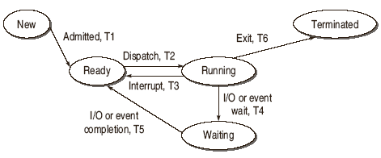
State Table Based Testing
Finite State Machine (FSM)
State Transition Diagrams or State Graph
© Oxford University Press 2011. All rights reserved.

Slide 16
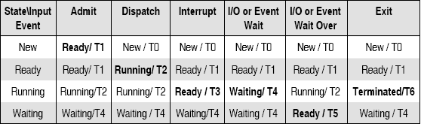
State Table Based Testing
State Table
© Oxford University Press 2011. All rights reserved.

Slide 17
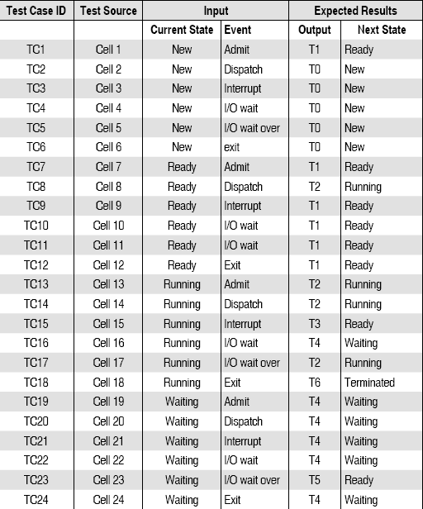
State Table Based Testing
© Oxford University Press 2011. All rights reserved.

Slide 18
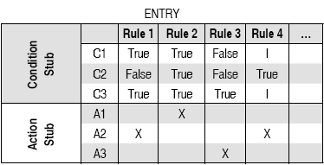
Decision Table Based Testing
© Oxford University Press 2011. All rights reserved.

Slide 19
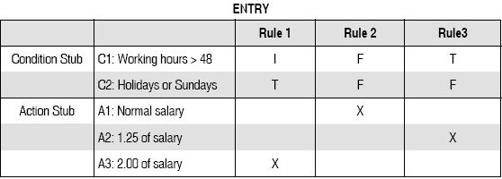
Decision Table Based Testing
Example
A program calculates the total salary of an employee with the conditions that if the working hours are less than or equal to 48, then give normal salary. The hours over 48 on normal working days are calculated at the rate of 1.25 of the salary. However, on holidays or Sundays, the hours are calculated at the rate of 2.00 times of the salary. Design the test cases using decision table testing.
© Oxford University Press 2011. All rights reserved.

Slide 20
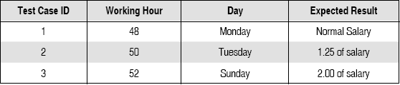
Decision Table Based Testing
© Oxford University Press 2011. All rights reserved.

Slide 21

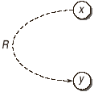


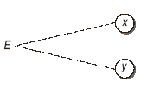
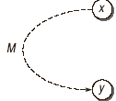
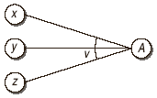
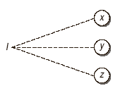

Cause-Effect Graphing based Testing
Basic Notations for Cause-Effect Graph
© Oxford University Press 2011. All rights reserved.

Slide 22
Cause-Effect Graphing based Testing
Example
A program has been designed for the determination of nature of roots of a quadratic equation. Quadratic equation takes three input values from the range [0,100]. Design all test cases using Cause-Effect graphing technique.
© Oxford University Press 2011. All rights reserved.

Slide 23
Cause-Effect Graphing based Testing
C1: a ≠ 0
C2: b = 0
C3: c = 0
C4: D > 0 where D is b2 – 4 * a * c
C5: D < 0
C6: D = 0
C7: a = b = c
C8: a = c = b/2
E1: Not a quadratic equation
E2: Real Roots
E3: Imaginary Roots
E4: Equal Roots
© Oxford University Press 2011. All rights reserved.

Slide 24
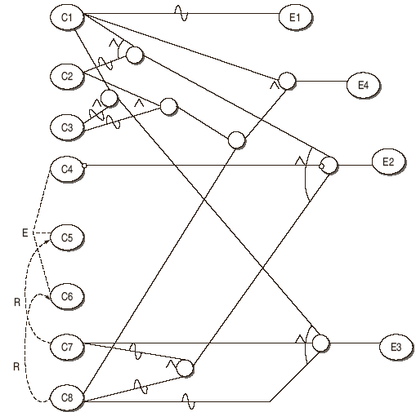
Cause-Effect Graphing based Testing
© Oxford University Press 2011. All rights reserved.

Slide 25
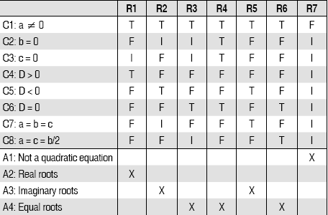
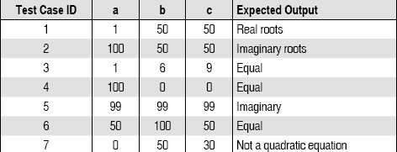
Cause-Effect Graphing Based Testing
© Oxford University Press 2011. All rights reserved.

Slide 26
Error Guessing
Error guessing is the method used when all other methods fail or it is the method for some special cases which need to be tested.
It means error or bug can be guessed which do not fit in any of the earlier defined situations. So test cases are generated for these special cases.
© Oxford University Press 2011. All rights reserved.

